Slide 1


A Texting-Based Virtual Assistant for NICU Families is valuable & feasible
Ashley D. Osborne MD

Slide 2
Disclosures
I have no financial disclosures
Development & programming support by Memora Health
Clinical Care Innovation Grant from Independence Blue Cross
Notes:
I have no financial disclosures. My virtual assistant work was supported by IBX with the clinical care innovation grant.

Slide 3

Background
>96% of Americans own mobile phones¹
60% of NICU mothers prefer texting²
Texting updates improves parent interactions with medical staff^{2,3}
Pew Research Center. 2019
Weems MF et al. J Perinatol. 2016
Globus et al. J Perinatol. 2016
Notes:
One potential way to decrease parent gaps in knowledge and also enhance FCC is leveraging eHealth, which is the use of digital information and communication technology to support health and healthcare.
Recently, there has been growing interest in the use of eHealth in NICUs to bridge communication and knowledge gaps. A recent systematic review of NICU electronic health interventions including 8 studies found that all studies indicated parental acceptance of incorporation of electronic interventions in the NICU. Specifically, text messaging or short message services (SMS) may be able to improve communication between parents and medical staff and increase parental understanding of their infant’s condition.⁷ Currently, SMS is an uncommon method of communication between medical teams and families despite the fact that over 96% of Americans own mobile phones.⁸ NICU mothers overall have a favorable view of electronic communication, and 60% identified texting as their preferred communication platform in one survey of over 200 NICU moms.⁷ In one study after implementation of medical updates via SMS, parents felt more comfortable approaching their infant’s physician and were more satisfied with information provided by staff.⁹ Overall the existing literature supports the use of eHealth, and specifically a text messaging platform for parental communication and education in the NICU.
Weems MF, Graetz I, Lan R, DeBaer LR, Beeman G. Electronic communication preferences among mothers in the neonatal intensive care unit. J Perinatol. 2016 Nov;36(11):997-1000. doi: 10.1038/jp.2016.125.
“Mobile Fact Sheet.” Pew Research Center, Washington, D.C. (June 12 2019) https://www.pewresearch.org/internet/fact-sheet/mobile/.
Globus O, Leibovitch L, Maayan-Metzger A, Schushan-Eisen I, Morag I, Mazkereth R, Glasser S, Kaplan G, Strauss T. The use of short message services (SMS) to provide medical updating to parents in the NICU. J Perinatol. 2016 Sep;36(9):739-43.
I’m very interested in leveraging technology to better assist medical teams in supporting NICU families.
. Although a systematic review of NICU electronic health interventions found no clear impact on neonatal outcomes, the review only included eight studies, most of which were of low quality, and a meta-analysis was ultimately unable to be performed due to heterogeneity of the studies.⁶ But in their analysis, Dol et al. did find that all studies indicated parental acceptance of incorporation of electronic interventions in the NICU.

Slide 4
Objectives
To design a novel, augmented intelligence, text-messaging virtual assistant for moderately preterm infant (MPTI, 32w0d-34w6d) birth parents
To describe the feasibility and acceptability of the virtual assistant among MPTI birth parents
Notes:
When parents seek knowledge relating to their premature child, popular options are calling a medical provider or turning to the unqualified internet community. We hypothesize that a novel text-messaging virtual assistant will be feasible and well-received by birth parents of moderately preterm infants with the potential to improve their NICU experience and their understanding of prematurity implications.
Population: Focus on moderately preterm infants account for ~22% of US preterm births^{4,}
As we know from our clinical practice, moderately preterm infants are a prevalent population. MPT account for ~3% of all births. You can see from the graph that moderate and late preterm infants comprise the majority of preterm births in the US and specifically MPTI account for ~22% of all PT births in the US. Their average LOS is 33 days & given the substantial size of this population, this leads to a significant cost to the healthcare system.
Despite their large population, Their care has been extrapolated from the care of the ext PT and full term babies, but really they are neither.

Slide 5
Methods
Needs Assessment
Semi-structured qualitative interviews
Penny Design
Engage stakeholders
Penny Testing
Create content
Pilot
Analyze Data
Convenience sample of 10 birth parents
Identify multidisciplinary champions
Internal testing
MTurk Testing
Measure NPS
Methods
Notes:
To inform the design and focus the virtual assistant content, a needs assessment was performed via semi-structured qualitative interviews with English-speaking birth parents of infants born between 32-34 weeks gestation who were recently discharged from the Hospital of University of Pennsylvania (HUP) NICU (38 bed, level III unit). Two team members analyzed the recorded, transcribed interviews using a modified grounded theory approach and enrollment was stopped when the data reached thematic saturation. NVivo 12 facilitated the analysis.
The virtual assistant, named “Penny,” was then created to fill the gaps of knowledge and needs identified by parents with HUP’s technology partner, Memora Health. Multidisciplinary stakeholders from nursing, lactation, social work, and psychology, were engaged to aid in design. Penny is designed for parent use during the NICU admission and for 6 weeks after discharge. Internal iterative testing and Amazon Mechanical Turk crowdsourced testing were performed. A convenience sample of 10 birth parents were enlisted to try Penny to assess the program’s feasibility and user acceptability. Parent satisfaction was measured by the Net Promoter Score (NPS), a widely used market research metric of customer experience (range -100 to 100). The qualitative study and Penny implementation met eligibility criteria for IRB review exemption.

Slide 6
Needs Assessment
Semi-structured qualitative interviews
Penny Design
Engage stakeholders
Penny Testing
Create content
Pilot
Analyze Data
Convenience sample of 10 birth parents
Identify multidisciplinary champions
Internal testing
MTurk Testing
Measure NPS

Slide 7
Needs Assessment
Semi-structured qualitative interviews
Penny Design
Engage stakeholders
Penny Testing
Create content
Pilot
Analyze Data
Convenience sample of 10 birth parents
Identify multidisciplinary champions
Internal testing
MTurk Testing
Measure NPS
Notes:
Not like Chat GPT, Bing not “artificial intelligence”
And I was able to take advantage of an existing Penny platform that exists for well baby nursery infants + moms, which was a huge success

Slide 8
Penny in the NICU
Respond to FAQs
1
Push content
2
Discharge “Launch Pad” program
3
Notes:
Penny’s functionality includes responding to commonly asked questions, sending scheduled educational content relating to prematurity and maternal postpartum care, and a discharge program to aid in discharge preparedness and the transition home.
What does Penny in the NICU look like?
1. FAQs: focus on feeding readiness and skills, everything from access to how to obtain free parking. Solicited input from lactation, RN, SW, Psych (Chavis/Casey)
2. Push content: Importance of ROP for <1500g, KMC, infection prevention, info on medical team, encourage parent involvement at the bedside (touching, diaper changes), mental health support (SW, EPDS screen), vaccines, CGA
3. “Launch pad” when the infant is nearing discharge. If infant is on 72h dc list → RN to edit Memora dashboard → Launch pad program
PCP appt, car seat, circ, SIDS & Shaken baby vids
Enroll at time of maternal discharge, have access to Penny for 6 weeks post-discharge
~100 items I created, also have access to WB content (380 items)– edited this to make it appropriate for preemies too

Slide 9
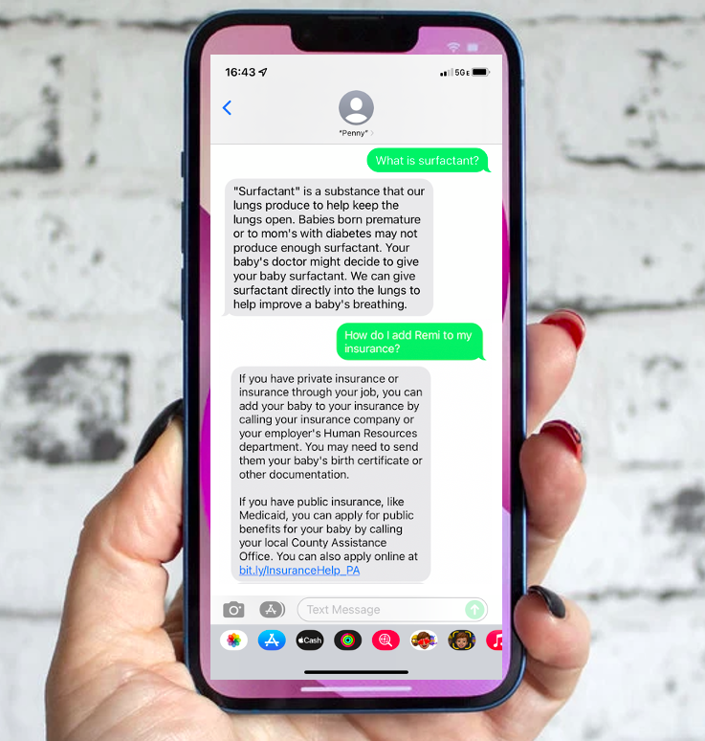
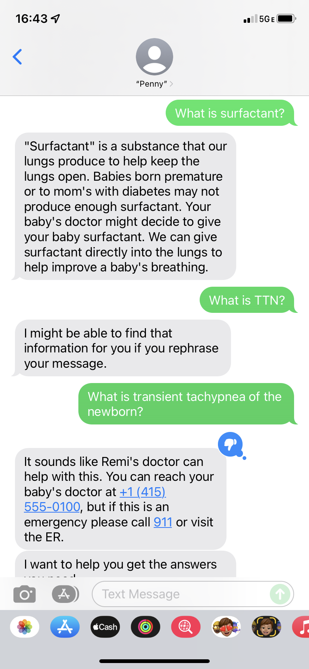
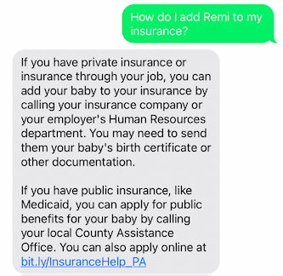

Slide 10
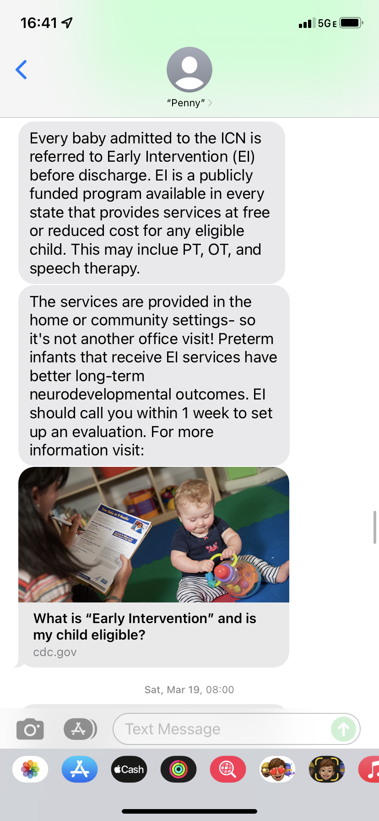
Notes:
Push message related to the “launch pad program” this is information on EI- publicly funding services & supports available in every satate for free or reduced cost to babies & young children with delays and disabilitiies

Slide 11
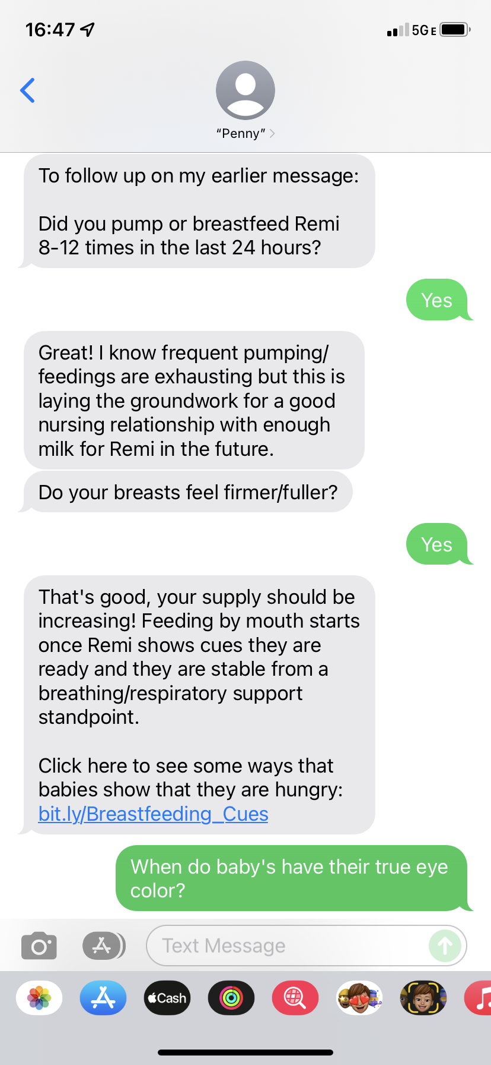
Notes:
Push question and response, in this case the parent didn’t respond to Penny initially, so she followed up a few hours later

Slide 12
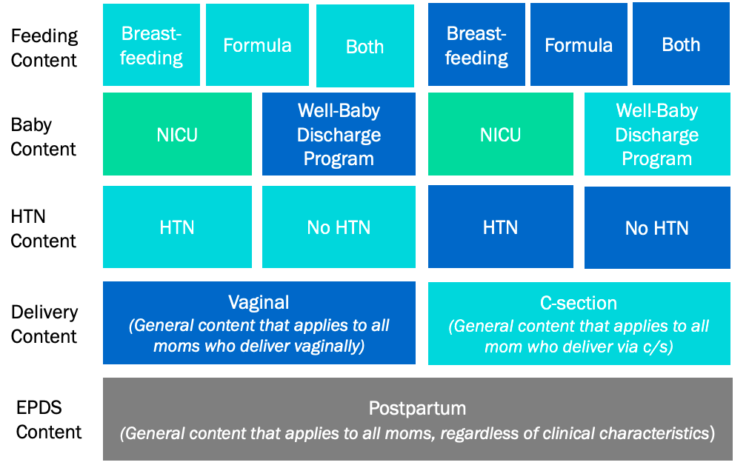
Penny in the NICU
Infant
NICU or
Home
Maternal
Notes:
Penny is an amazing example of using eHealth in the care of the dyad- a marriage obgyn care with newborn care.
Depiction of how content is layer in Penny. The baby content is layered on top of the maternal content.
Edinburgh Postnatal Depression Scale/Screen
Newborn content can stand alone from maternal content.
Enroll mothers at time of discharge -> will either go into the “NICU program” or the “well baby discharge program”
Maternal data will remain
Clinician oversight to ensure safety

Slide 13
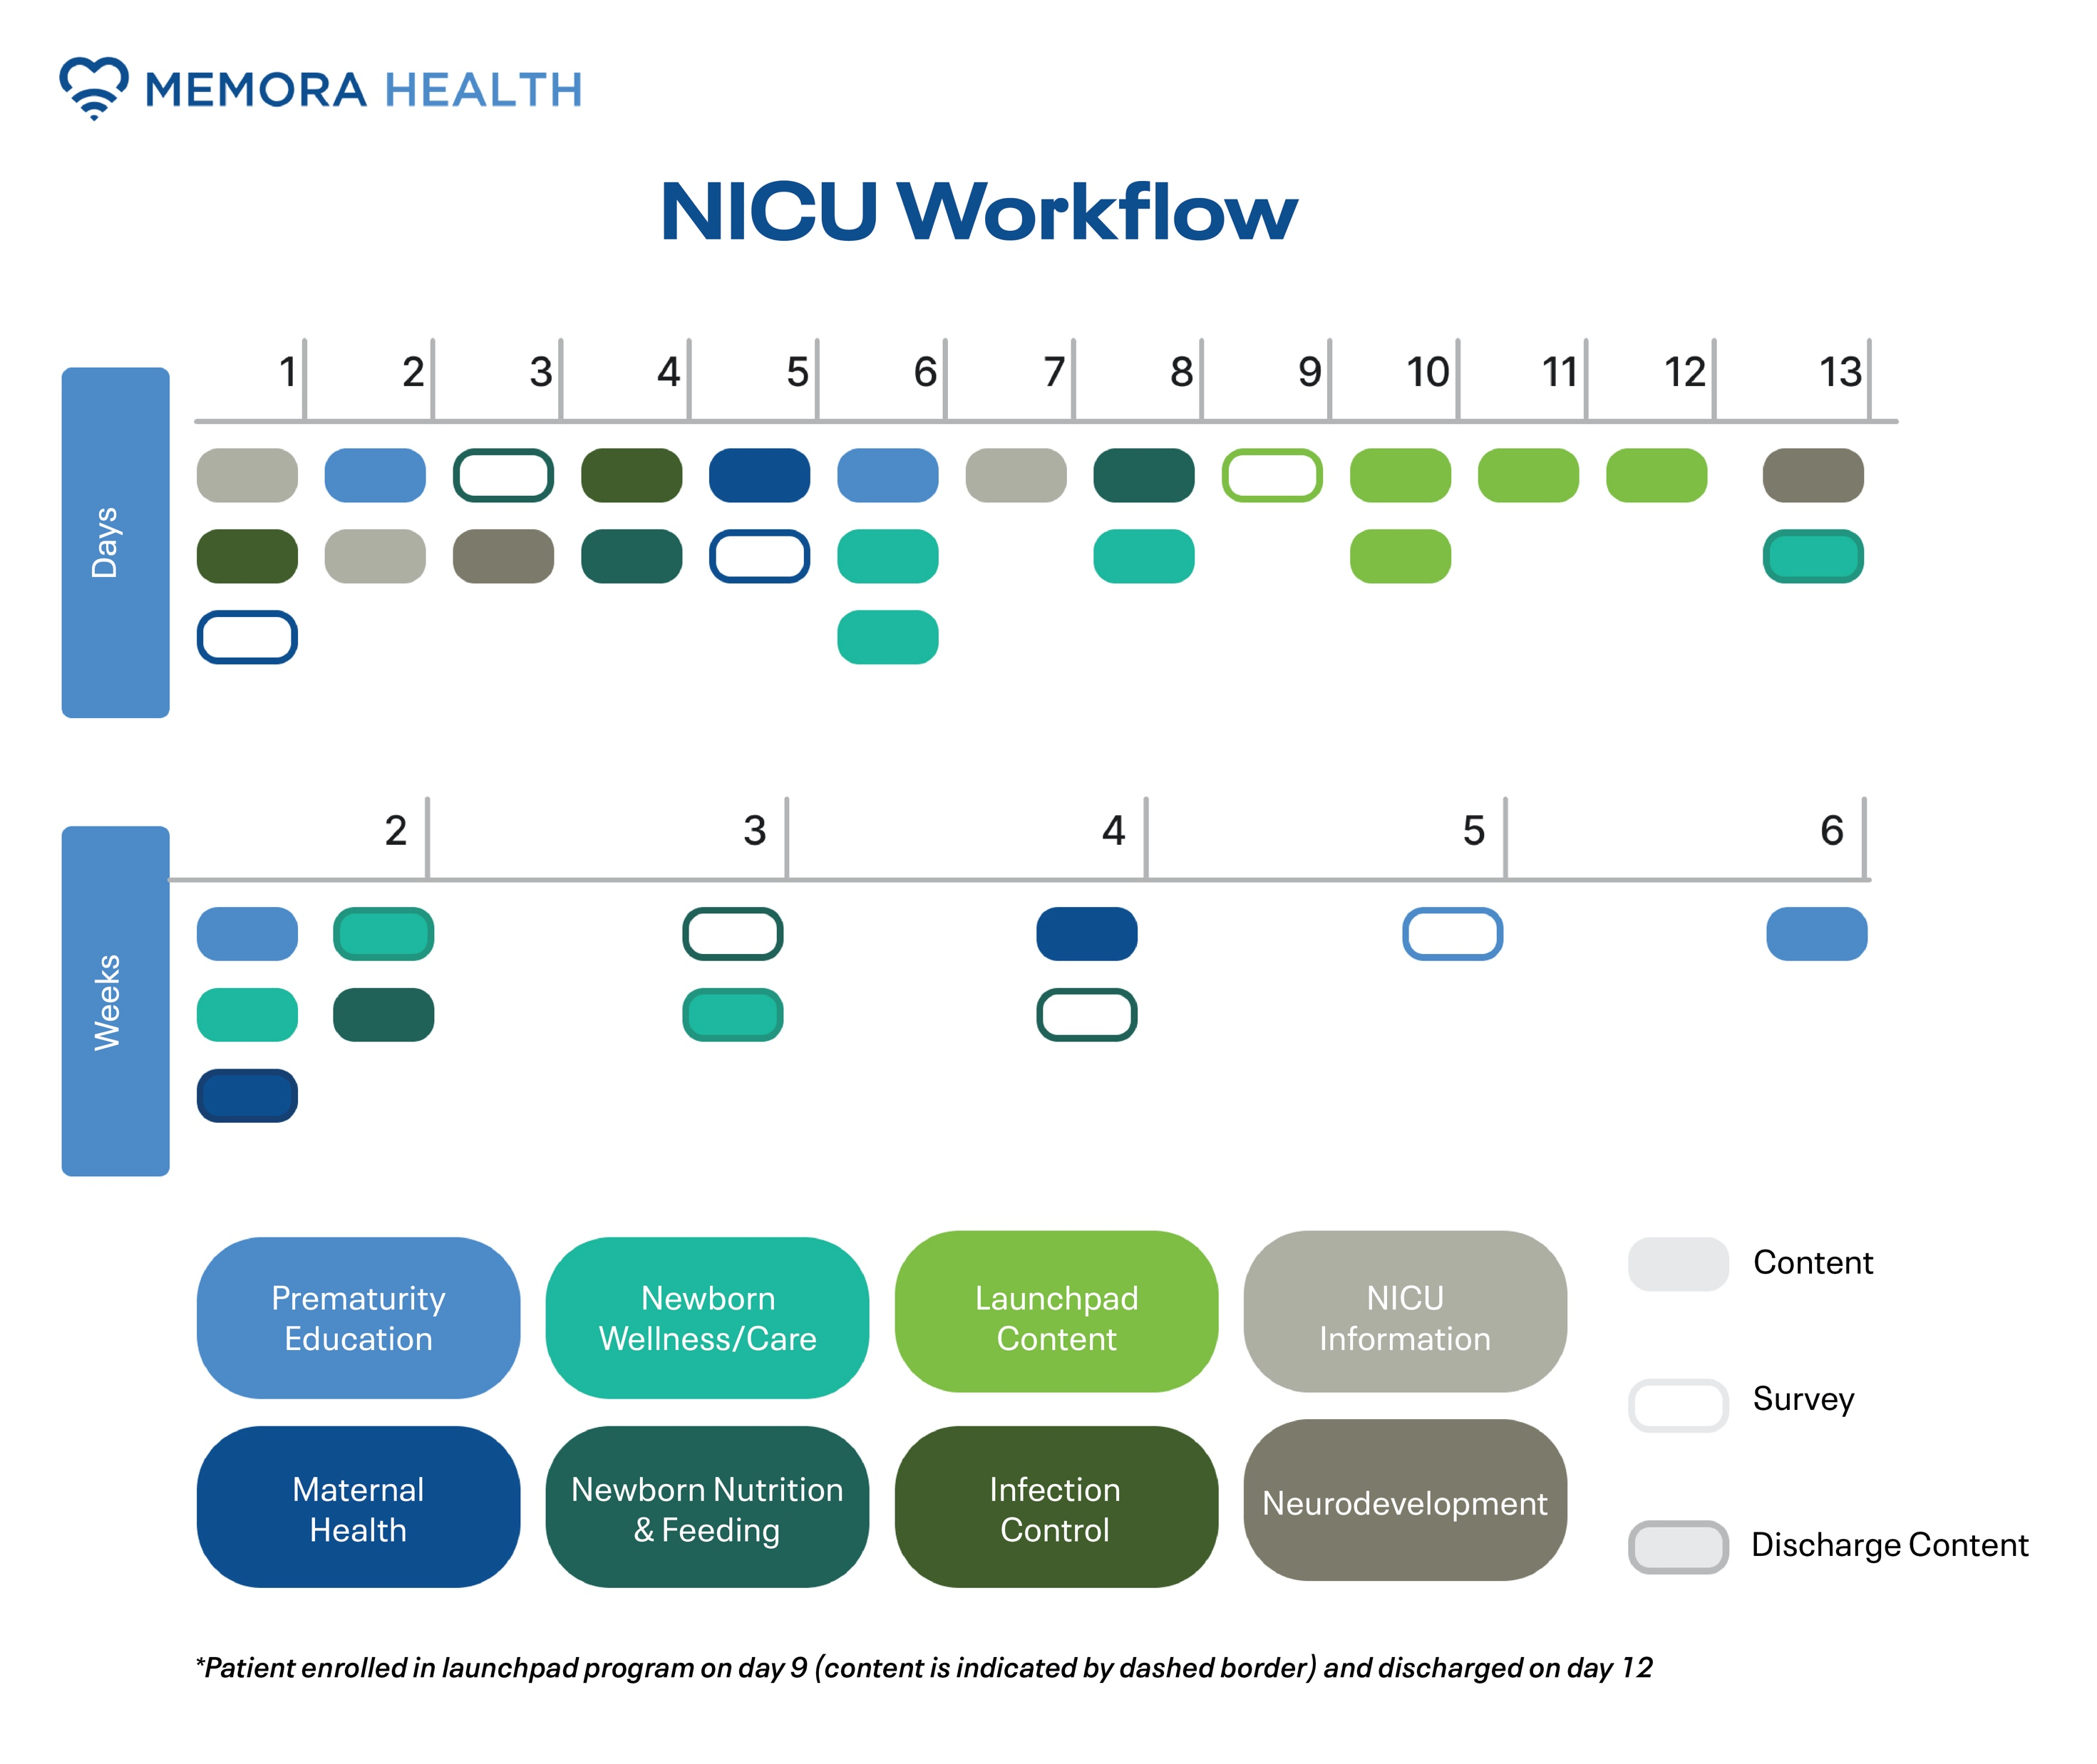
Notes:
This is a figure depicting the scheduled “pushed” content Penny sends out. Penny pushes content related to different topics important to the NICU parent shown here in different colors, such as information on prematurity in general, maternal health, feeding & nutrition, NICU unit information and neurodevelopment. You can see most of the content is delivered in the first 2 weeks. In this example, the infant was discharged on DOL 12, but Penny continues to send educational content even after discharge to support the transition home. And moms can continue utilizing Penny to ask FAQs.

Slide 14
Needs Assessment
Semi-structured qualitative interviews
Penny Design
Engage stakeholders
Penny Testing
Create content
Pilot
Analyze Data
Convenience sample of 10 birth parents
Identify multidisciplinary champions
Internal testing
MTurk Testing
Measure NPS
Notes:
After I completed Penny’s design, I organized internal texting with stakeholders, and I am also continuously testing Penny. We also performed Mturk testing, which is essentially crowdsourcing through Amazon. With more testing, Penny’s natural language process can improve and she becomes “smarter”

Slide 15
Needs Assessment
Semi-structured qualitative interviews
Penny Design
Engage stakeholders
Penny Testing
Create content
Pilot
Analyze Data
Convenience sample of 10 birth parents
Identify multidisciplinary champions
Internal testing
MTurk Testing
Measure NPS
Notes:
began our implementation pilot
Primary measurement of acceptability was NPS

Slide 16



Net Promoter Score (NPS)
Net Promoter Score = % Promoters - % Detractors
1 2 3 4 5 6 7 8 9 10
Notes:
widely used market research metric that is based on a single survey question asking how likely you are to recommend “x” to a friend
Main metric of acceptability among birth parents was the NPS
1-6 detractors, 7-8 neutrals, 9-10 promoters
Range: -100 = +100 and in general in the positives is good, and if you are >80 is amazing. Top 25% for professional services have >72, tech > 64
Medians are 40-50

Slide 17
Results
10 parents enrolled, none declined
NPS = 83
Users sent 149 messages
Penny sent 797 messages
Clinician oversight time: ~1-2 minutes/day
Notes:
A convenience sample of 10 birth parents were enrolled in Penny. No parents declined enrollment. Penny’s NPS was 80 (1 additional response- so now 83, 6 responded to NPS question). Parents felt Penny provided “reliable,” “helpful,” and “comprehensive” information and kept “mothers updated on their {infant’s} journey after birth.” Users sent 149 messages and Penny sent 797 outbound messages, which were all automated except 1 message. The overall survey response rate was 41% of 12 surveys sent per user. Highest engagement was seen related to breastfeeding/pumping content, with greater than 75% of parents responding to Penny’s questions. 23% of Edinburgh Postnatal Depression Scale (EPDS) surveys were completed, with no parents screening positive for postpartum depression. All responding parents agreed strongly with “Penny increased my understanding of my premature baby both during and after their NICU stay.” Time spent by a clinician overseeing the program to ensure safety was minimal (1-2 minutes/day).
Aug 2022- Nov 2022
Most current NPS is 69- lowest score is a 7 (one mom first rated a 0 & a 10 on the next assessment so I am not counting that one)
54% of users rate Penny a 10

Slide 18
Results: Participants
User Characteristics (n=10)
User age (years, mean ± SD) | 31.3 ± 7.3
Gender (% Female) | 100%
Race Black White Asian Other | 70% 10% 10% 10%
Hispanic or Latinx origin | 20%
Insurance Type (% Medicaid) | 40%
Marital Status (% Married) | 40%
Infant Gestational Age (weeks/days, mean ± SD) | 34w1d ± 3d
Notes:
Is reflective of our parent population at HUP. All users identified as female, the average age was 31. The average gestational age of their infants at birth was 34w1d.

Slide 19
Select Survey Completion Rates
 | # Received Surveys | Survey Responses, n (%)
Day 2 Pumping/Breastfeeding | 10 | 8 (80%)
Launchpad: Any interaction Breastfeeding PCP appointment | 9 9 5 | 7, (78%) 7, (78%) 4, (90%)
4 week feeding check-in | 10 | 4, (40%)
≥ 1 EPDS completed | 10 | 4, (40%)
NPS | 10 | 6, (60%)
Notes:
Select survey response rates
Launchpad surveys are connected which is why not all moms didn’t receive- if you don’t answer a question, it doesn’t move on to the next. We also noticed some issues with the programming so not all surveys were sent- once identified, this was corrected
The overall survey response rate was 41% of o avg 12 surveys sent per user. Highest engagement was seen related to breastfeeding/pumping content and with the launchpad program. 40% of moms completed at least 1 Edinburgh Postnatal Depression Scale (EPDS), with no parents screening positive for postpartum depression.
All responding parents (n=4) agreed or agreed strongly with “Penny increased my understanding of my premature baby both during and after their NICU stay.”
Lots of surveys incomplete. Questions about Penny improving parent understanding and discharge readiness are poorly interacted with

Slide 20

User Testimonials
I think it's a helpful tool to have
Keeping mothers updated on their journey after birth
Reliable
information
The checking in
Comprehensive information
Notes:
When asked via Penny what is the primary reason for their score, parents responded…
Parents felt Penny provided “reliable,” “helpful,” and “comprehensive” information and kept “mothers updated on their {infant’s} journey after birth.”

Slide 21
Conclusions
Parents of MPTI describe needs for improved communication and education during and after their infant’s NICU stay
Penny implementation is feasible and highly accepted by MPTI parents
Penny’s NPS is excellent by industry standards
Required clinician oversight for Penny is minimal
Notes:
Implementation of a texting virtual assistant is feasible and highly accepted by parents of MPTIs. In this small sample, Penny’s NPS is excellent by industry standards and clinician oversight time was minimal. Penny has the potential to improve MPTI parental understanding of the implications of prematurity, discharge readiness, emotional well-being and overall NICU experience.
parents of MPTI we can focus improvement efforts on improving communication, specifically around reasons for admission and discharge planning, families desire and are accepting of electronic communication, and families have ongoing questions & education needs post-NICU discharge

Slide 22
Future Directions
Measure impact on discharge readiness, understanding of prematurity, emotional well-being
Use by other hospitals
Higher personalization and integration with EMR
Expand use in patient populations & partners
Notes:
Continue
City of Philly supporting a city-wide trial of Penny
Ideas how this could be applicable or used at your hospital? Needs that you have identified
Applicable for follow-up- future goals for ALL mothers/babies- could help adherence to f/u program

Slide 23
References
Umberger E, Canvasser J, Hall SL. Enhancing NICU parent engagement and empowerment. Semin Pediatr Surg. 2018 Feb;27(1):19-24.
Purdy IB, Craig JW, Zeanah P. NICU discharge planning and beyond: recommendations for parent psychosocial support. J Perinatol. 2015 Dec;35 Suppl 1(Suppl 1):S24-8.
Smith VC, Hwang SS, Dukhovny D, Young S, Pursley DM. Neonatal intensive care unit discharge preparation, family readiness and infant outcomes: connecting the dots. J Perinatol. 2013 Jun;33(6):415-21.
Dunn MS, Reilly MC, Johnston AM, Hoopes RD Jr, Abraham MR. Development and dissemination of potentially better practices for the provision of family-centered care in neonatology: the family-centered care map. Pediatrics. 2006 Nov;118 Suppl 2:S95-107.
Chhabra D, Joymon J, Lee BH, Mercado M, Hunter CL, Viola D, Tahara D, Damus K, La Gamma EF, Brumberg HL. Delivery-related knowledge of mothers of NICU infants compared with well-baby-nursery infants. J Perinat Med. 2014 Nov;42(6):717-24.
Eneriz-Wiemer M, Liu SD, Chu MCY, Uribe-Leitz T, Rajani K, Sankar M, Robbins SL, Lee HC, Woodard C, Wang CJ. Parents' Knowledge and Education of Retinopathy of Prematurity in Four California Neonatal Intensive Care Units. Am J Ophthalmol. 2018 Jul;191:7-13. doi: 10.1016/j.ajo.2018.03.039.
Weems MF, Graetz I, Lan R, DeBaer LR, Beeman G. Electronic communication preferences among mothers in the neonatal intensive care unit. J Perinatol. 2016 Nov;36(11):997-1000. doi: 10.1038/jp.2016.125.
“Mobile Fact Sheet.” Pew Research Center, Washington, D.C. (June 12 2019) https://www.pewresearch.org/internet/fact-sheet/mobile
Globus O, Leibovitch L, Maayan-Metzger A, Schushan-Eisen I, Morag I, Mazkereth R, Glasser S, Kaplan G, Strauss T. The use of short message services (SMS) to provide medical updating to parents in the NICU. J Perinatol. 2016 Sep;36(9):739-43.
Garfield CF, Kerrigan E, Christie R, Jackson KL, Lee YS. A Mobile Health Intervention to Support Parenting Self-efficacy in the Neonatal Intensive Care Unit from Admission to Home. J Pediatr. 2022 Jan 13:S0022-3476(22)00004-X. doi: 10.1016/j.jpeds.2022.01.004. Epub ahead of print. PMID: 35033562.
Walsh MC, Bell EF, Kandefer S, Saha S, Carlo WA, D'angio CT, Laptook AR, Sanchez PJ, Stoll BJ, Shankaran S, Van Meurs KP, Cook N, Higgins RD, Das A, Newman NS, Schibler K, Schmidt B, Cotten CM, Poindexter BB, Watterberg KL, Truog WE. Neonatal outcomes of moderately preterm infants compared to extremely preterm infants. Pediatr Res. 2017 Aug;82(2):297-304. doi: 10.1038/pr.2017.46.
Trembath AN, Payne AH, Colaizy TT, Bell EF, Walsh MC. The problems of moderate preterm infants. Semin Perinatol. 2016 Oct;40(6):370-373. doi: 10.1053/j.semperi.2016.05.008. Epub 2016 Sep 13. PMID: 27637133; PMCID: PMC5065732.
Vohr B. Long-term outcomes of moderately preterm, late preterm, and early term infants. Clin Perinatol. 2013 Dec;40(4):739-51. doi: 10.1016/j.clp.2013.07.006. Epub 2013 Sep 20. PMID: 24182959.

Slide 24




Questions/Comments?
@drashleyosborne
@doctor.ashley
ashley.osborne25@gmail.com
Notes:
Why not an RCT?
- Largely feasibility at this point of time, and also I really view this pilot program as an extension of the design process of Penny- I expect we will add content, edit certain functionalities etc. but in the future, I would be excited to do an RCT and I am hoping that is in Penny’s future. With every user Penny will become “smarter

